Slide 1
Advanced Computer Architecture
School of Computer, National University of Defense Technology
Lecture 08.
Mulit-Issue: Scheduling & Prediction
Dr. SHEN Li
2019.11.27

Slide 2
Homework
Textbook
H.6 The Intel Itanium Architecture and Itanium Processor
Paper
The Transmeta Code MorphingTM Software: Using Speculation, Recovery, and Adaptive Retranslation to Address Real-life Challenges

Slide 3
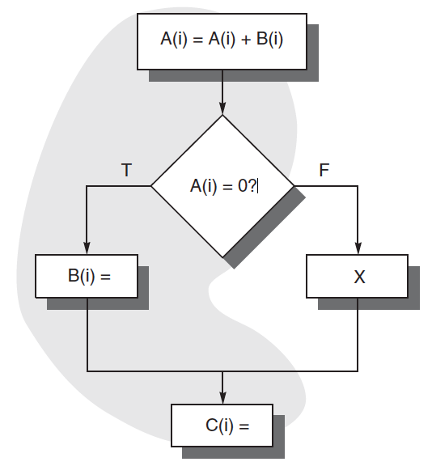
Global Instruction Schuedling
Instructions are scheduled accossing the boundary of basic blocks.

Slide 4
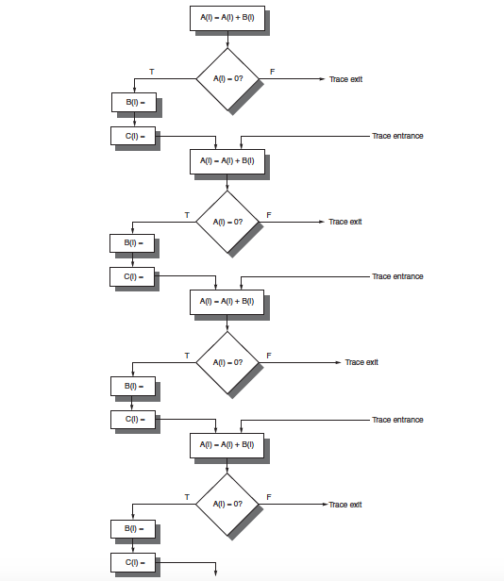
Trace Scheduling

Slide 5
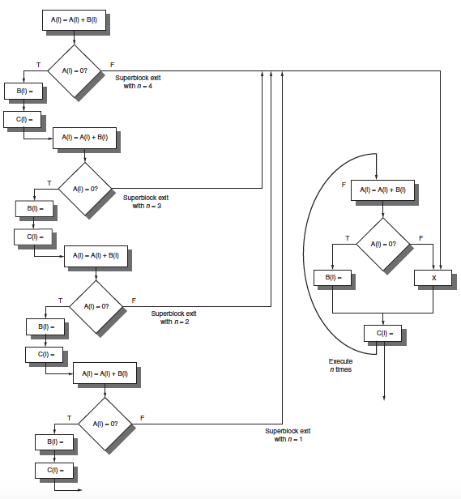
Superblock Scheduling

Slide 6

Predicated Instructions
if (A==0) {S==T;}
BNEZ R1, L
ADDU R2, R3, R0
L:
CMOVZ R2, R3, R1

Slide 7
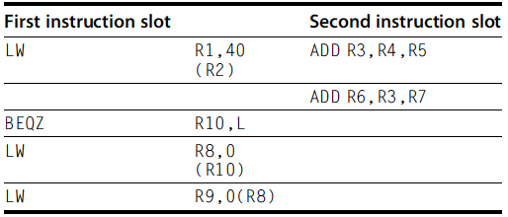
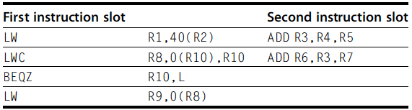
Predicated Instructions

Slide 8
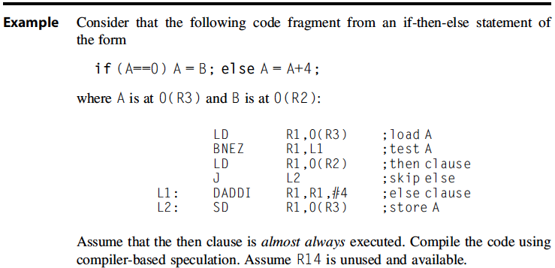
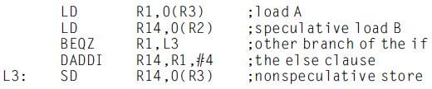
Compiler Speculation

Slide 9
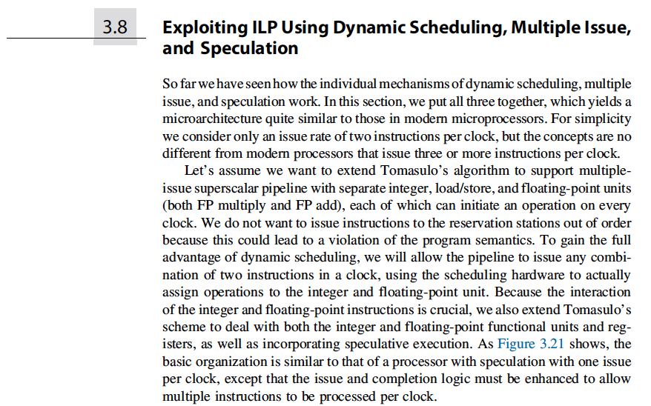
Self-learning

Slide 10
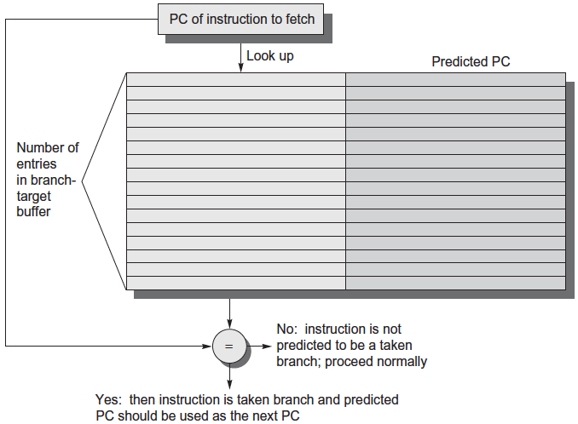
Branch Target Buffer

Slide 11
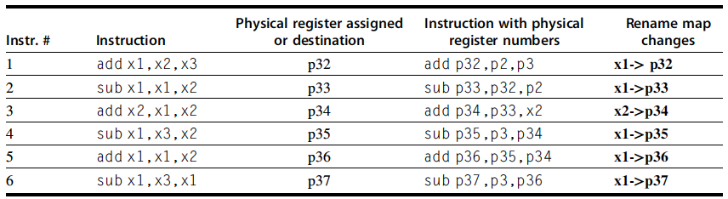
Issues caused by Multi-Issue

Slide 12
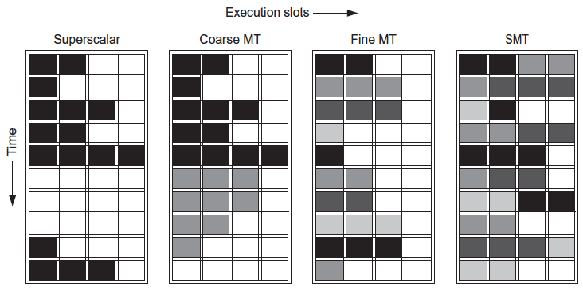
Simultaneous Multi-Threading

Slide 13
Homework 11.27
Textbook
3.9 Advanced Techniques for Instruction Delivery and Speculation
3.11 Multi-threading: Exploiting Thread-Level Parallelism to Improve Uniprocessor

